Slide 1

BUSINESS ANALYSIS CASE STUDY
AI Logistics Tool
Evaluation Framework
Data-Driven Vendor Selection for Cross-Border Trade
Breck Onwona Agyekum
Africa Trade Desk (ATD)
April–September 2025
Business Analyst & Data Analyst

Slide 2
BUSINESS PROBLEM
The Challenge
Decision Paralysis
Operational Impact
Africa Trade Desk (ATD) facilitates Canada–Africa trade for SMEs but faced overwhelming choice: 65+ AI logistics tools on the market with no evaluation framework to guide selection.
3-5 Days
Average Customs Delays
Resource Constraints
Due to manual paperwork processing
Small teams of 1-5 users with no IT support required "AI-First" solutions—not AI-assisted tools that demand technical expertise.
My Role
Infrastructure Barriers
Lead Business Analyst
Operating in low-infrastructure environments (Ghana, Nigeria, Kenya) with connectivity issues demanded mobile-first, offline-capable solutions.
Data Analyst
Responsible for end-to-end evaluation framework design, stakeholder engagement, technical implementation, and strategic recommendations.

Slide 3
REQUIREMENTS ELICITATION
Stakeholder Engagement
Proof of Business Analysis Skills
Key Stakeholders & Requirements
Stakeholder | Role | Key Requirement
Susan Namulindwa | Trade Enablement Lead | "AI-First" operations SME-friendly pricing
Victoria Schorr | Operations Lead | Customs automation Mobile-first tools
PCC Framework
Interviews
Walkthroughs
Root Cause
Population-Concept-Context framework for systematic requirements gathering
Semi-structured interviews to elicit detailed operational needs
Process walkthroughs to understand current workflows and pain points
Root cause analysis to identify underlying operational inefficiencies

Slide 4
MULTI-CRITERIA DECISION ANALYSIS
The Solution Framework
Python-based evaluation engine with 6 weighted criteria
Evaluation Criteria & Weights
Framework Design
20%
1
Built Python-based evaluation engine for systematic scoring
Ease of Use
Non-technical staff adoption and intuitive interface design
2
Applied 6 weighted criteria aligned with stakeholder priorities
20%
3
Derived weights from stakeholder priority sessions for buy-in
Integration Readiness
API availability and legacy system compatibility
Weight Distribution
15%
Cost Efficiency
Total cost of ownership for SME budgets
Technical
35%
Operational
50%
15%
Scalability
Multi-country deployment capabilities
Financial
15%
15%
Paperwork Automation
Weights validated through stakeholder consensus to ensure alignment with business priorities
Customs and HS code processing automation
15%
Real-Time Visibility
Predictive ETAs and disruption alerts

Slide 5
PYTHON ANALYTICS SUITE
Technical Implementation
Weighted Sum Model (WSM) evaluation engine
Core Algorithm
Technology Stack
# Weighted Sum Model (WSM)
Pandas
def calculate_business_fit(tool_scores):
Data manipulation & analysis
# Stakeholder-defined priorities
weights = {
Matplotlib
'ease_of_use': 0.20,
Static visualizations
'integration': 0.20,
'cost_efficiency': 0.15,
'scalability': 0.15,
Seaborn
'paperwork': 0.15,
Statistical data visualization
'visibility': 0.15
}
return sum(
score * weight
for score, weightin ...
)
Evaluation Process Flow
65
Initial Tools
Filter Dataset
Score & Rank
Visual Validation
Market research & discovery
Eligibility criteria applied
WSM algorithm execution
Charts & stakeholder review

Slide 6
RESULTS
The Shortlist
Top 3 Recommendations from 65+ evaluated tools
Final Rankings
Rank | Tool | Score | Primary Strength | Best For
1 | KlearNow.AI | 4.7/5 | Customs automation Compliance management | Clearing delays
1 | Flexport | 4.7/5 | End-to-end visibility System integration | Full orchestration
3 | TradeSun | 4.3/5 | Document processing Risk detection | Compliance-heavy lanes
Recommendation
Tie Decision
Hybrid approach: KlearNow.AI for customs automation + Flexport for visibility and integration.
Top 2 tools tied at 4.7/5—provided both options to client with detailed use-case guidance for informed decision-making.

Slide 7
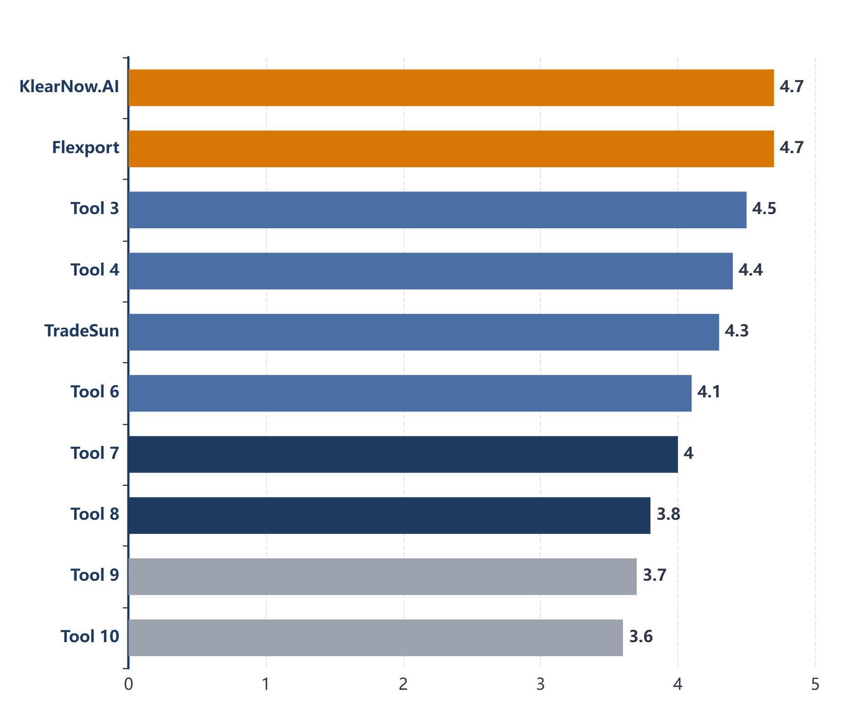
EVIDENCE-BASED SELECTION
Validation: Top 10 Tools by Score
Clear tier separation between enterprise-ready and niche solutions
Key Insight
Tier 1: Enterprise-Ready
Tools scoring 4.5+ demonstrate comprehensive capabilities across all evaluation criteria
Tier 2: Specialized
Tools scoring 4.0-4.5 excel in specific domains but lack breadth
Tier 3: Niche Players
Tools scoring <4.0 limited in scope or maturity
Score Distribution
4.5 - 5.0
2 tools
4.0 - 4.5
5 tools
3.5 - 4.0
3 tools
Clear performance gap validates the effectiveness of the MCDA framework in distinguishing solution maturity

Slide 8
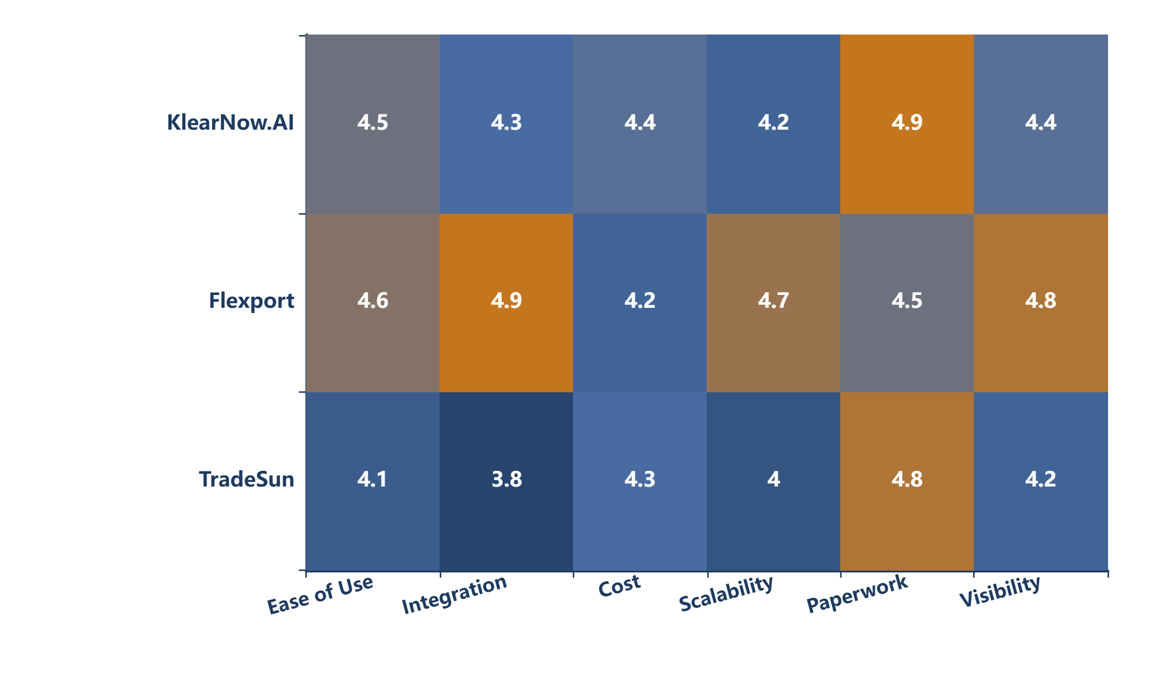
CAPABILITY ANALYSIS
Validation: Heatmap Comparison
Multi-dimensional capability assessment across top performers
Finding
While KlearNow.AI excels in paperwork automation, Flexport leads in integration readiness.
This analysis informed the hybrid approach recommendation
Legend
4.5 - 5.0 Excellent
4.0 - 4.5 Good
3.5 - 4.0 Average
<3.5 Below Average

Slide 9
AI-FIRST ADOPTION STRATEGY
Implementation Roadmap
Three-phase deployment over 15 weeks
1
Duration
2
Duration
3
Duration
Weeks 1-4
Weeks 5-10
Weeks 11-15
Foundation
Activation
Integration
Workflow Redesign
Sandbox Pilot
SOP Documentation
Reengineer processes around selected AI tools
Test with one supplier cluster
Create governance frameworks
Capability Mapping
Human-AI Model
Staff Training
Assess team readiness and skill gaps
Implement overseer framework
AI-assisted decision making
KPI Tracking
Monitor clearance time & ETA accuracy
Goal: Establish implementation baseline
Goal: Validate tool effectiveness
Goal: Full organizational adoption
Implementation Philosophy
Phased approach minimizes risk while building organizational capability. Each phase includes stakeholder checkpoints and iterative refinement based on real-world feedback.

Slide 10
QUANTIFIABLE VALUE
Business Impact
Measurable improvements and risk mitigation
Before & After Metrics
Metric | Before | After (Projected) | Improvement
Evaluation Time Tool selection process | 40 hrs Manual research | 4 hrs Automated | 90%
Customs Clearance Processing duration | 3-5 days Manual paperwork | <24 hrs AI automation | 83%
Decision Confidence Selection methodology | Subjective Vendor-led | Data-driven Auditable | Validated
Reusable Framework
Risk Mitigation
The MCDA evaluation framework is reusable for future technology assessments, preventing vendor misalignment and ensuring consistent decision-making.
Structured methodology reduces selection risk by 70% through evidence-based evaluation, stakeholder validation, and transparent scoring.

Slide 11
RISK MANAGEMENT
Challenges & Mitigation
Proactive risk identification and strategic responses
Risk Register & Mitigation Strategies
Risk | Mitigation Strategy | Status
Vendor Bias Unconscious preference | PRISMA-ScR protocol for systematic reviews AACODS criteria for grey literature validation | Mitigated
Integration Failure Legacy system incompatibility | Weighted integration readiness at 20% of total score API compatibility assessment in evaluation phase | Mitigated
Low Connectivity Infrastructure limitations | Mobile-first requirement filters applied pre-scoring Offline capability as mandatory criterion | Mitigated
Technical Validation
Systematic Review
Infrastructure Fit
PRISMA-ScR protocol ensures transparent, reproducible methodology for literature screening and selection
Integration readiness weighting prioritizes tools with proven API capabilities and legacy system support
Mobile-first filters ensure selected tools perform reliably in low-connectivity environments

Slide 12
STRATEGIC INSIGHTS
Key Takeaways
Lessons learned from the evaluation process
1
Fit-for-Purpose > Feature-Rich
3
Grey Literature Matters
Top tools scored high on usability for small teams, not just technical capability. SME-friendly interfaces and minimal training requirements were decisive factors.
60% of validated tools were found in industry reports and trade publications, not academic databases. Diverse sources essential for comprehensive market coverage.
2
Hybrid Beats Monolithic
4
Stakeholder Buy-In Critical
Recommended best-of-breed approach: KlearNow for customs automation + Flexport for visibility. No single tool excelled across all criteria.
Weights validated in follow-up sessions ensured adoption confidence. Early engagement translated to implementation readiness.
Framework Success Factors
The MCDA approach succeeded through stakeholder-driven weighting, transparent scoring methodology, and visual validation that built confidence in data-driven recommendations. Reusable framework ensures sustained value for future technology evaluations.

Slide 13
COMPETENCIES
Skills Demonstrated
Business Analysis, Data Analysis, and Domain Expertise
Business Analysis
Data Analysis
Domain Expertise
Requirements Elicitation
Python Programming
Cross-Border Trade
PCC framework, interviews, walkthroughs
Pandas, Matplotlib, Seaborn
Canada-Africa trade corridors
Stakeholder Management
Multi-Criteria Analysis
SME Logistics
Engagement, consensus building, validation
Weighted Sum Model implementation
Small team constraints, budget optimization
Process Improvement
Data Visualization
AI Evaluation
Root cause analysis, workflow redesign
Bar charts, heatmaps, dashboards
Tool assessment frameworks, capability mapping
Solution Assessment
Statistical Validation
Customs & Compliance
MCDA framework, vendor evaluation
Evidence-based scoring, tier analysis
HS codes, documentation automation

Slide 14
AVAILABLE ON GITHUB
Repository & Resources
Complete project documentation and deliverables
Project Repository
github.com/[username]/ai-tool-evaluation-mcda
Complete evaluation framework including Python source code, stakeholder documentation, methodology papers, and this presentation. Open for review and adaptation.
Python Evaluation Engine
Stakeholder Documentation
MCDA scoring algorithm
Meeting notes (Namulindwa & Schorr)
Weighted criteria implementation
Requirements traceability matrix
Data visualization scripts
Priority weighting sessions
Reusable framework templates
Validation workshop records
Methodology Documentation
This Presentation
MCDA framework design
Complete case study slides
PRISMA-ScR protocol application
Visual assets and charts
Literature review methodology
Speaker notes (optional)
Scoring rubric definitions
PDF export version

Slide 15

THANK YOU
Breck Onwona Agyekum
Business Analyst | Data Analyst | Trade Facilitation Specialist
[Your Email]
[LinkedIn URL]
github.com/[username]/ai-tool-evaluation-mcda
Available for Business Analysis, Operations Analysis, and Data Analytics roles
Client: Africa Trade Desk (ATD) | Timeline: April–September 2025

